Slide 1
Cyclistic Bike-Share Analysis
GOOGLE CAPSTONE PROJECT
Tools used : R for data cleaning
Tableau for data visalization

Slide 2
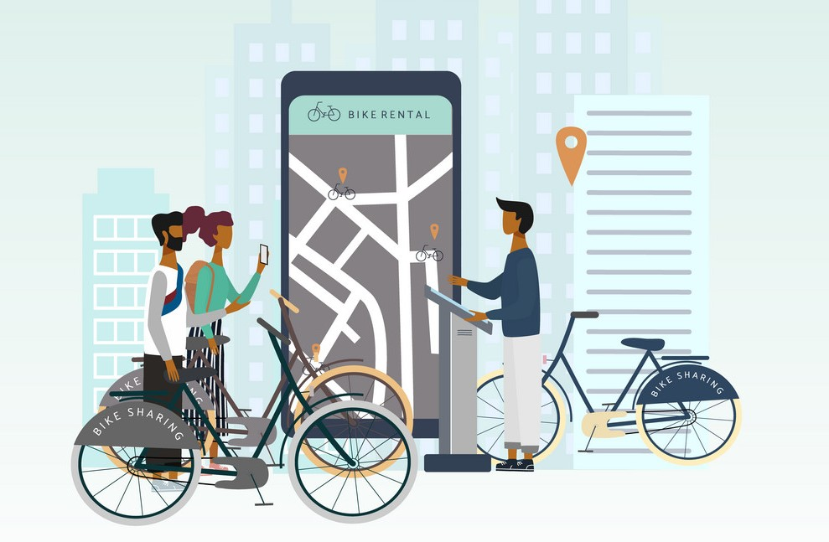
BUSINESS TASK :
How Does a Bike-Share Navigate Speedy Success?

Slide 3
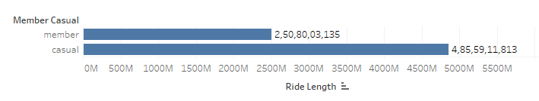
This graph shows the Total ride duration by the people which has Membership and the Casual people

Slide 4
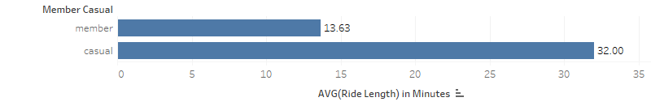
This graph shows the Average ride duration by the people which has Membership and the Casual people

Slide 5
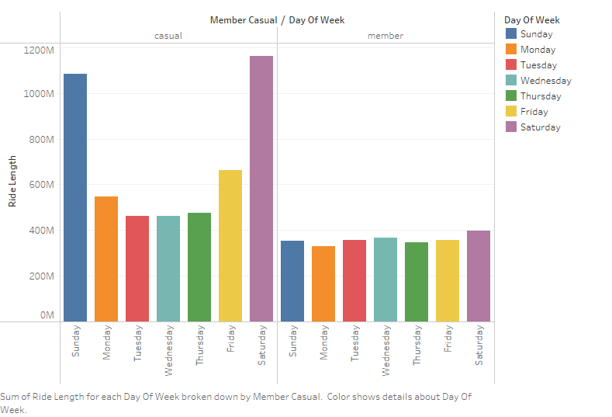
This graph shows the Total ride duration on Weekdays by the people which has Membership and the Casual people

Slide 6
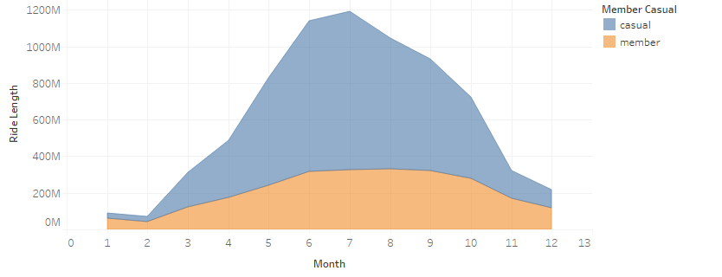
This graph shows the Total ride duration in Months by the people which has Membership and the Casual people

Slide 7
The key findings and my recommendations for the marketing campaign are as follows:
To guide the marketing campaign to convert casual riders into members, we now have some data driven insights on how casual riders and annual members use Cyclistic bikes differently.
1. Casual riders prefer to take longer trips averaging 32 minutes per trip compared to members who average only 13 minutes.
2. Use this statistic to show casual riders how they could save more money in the long run by becoming a member instead of paying for rides based on trip duration.
3. Introduce a member only rewards program based on trip duration to incentivize casual riders to sign up as members and be eligible for the rewards.
4. Develop a weekend and monthly membership plan where members have the option to book rides on weekdays and particular months at a lower rate.

